Slide 1
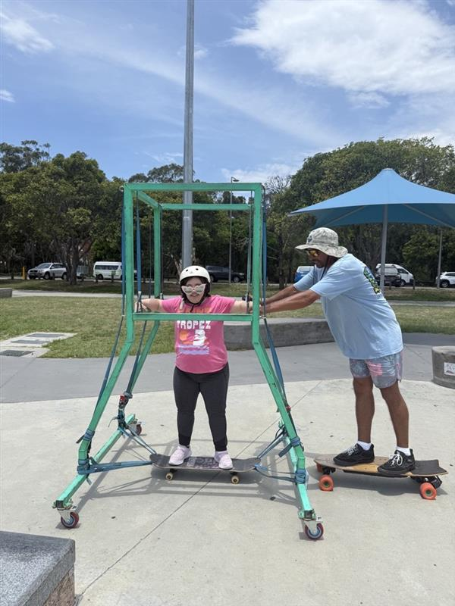
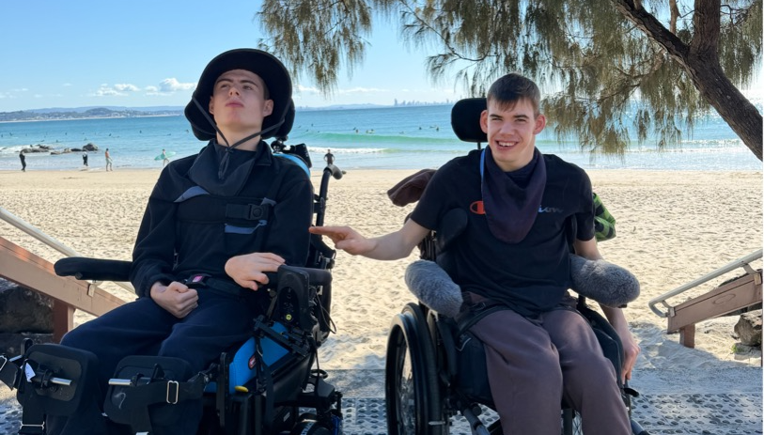
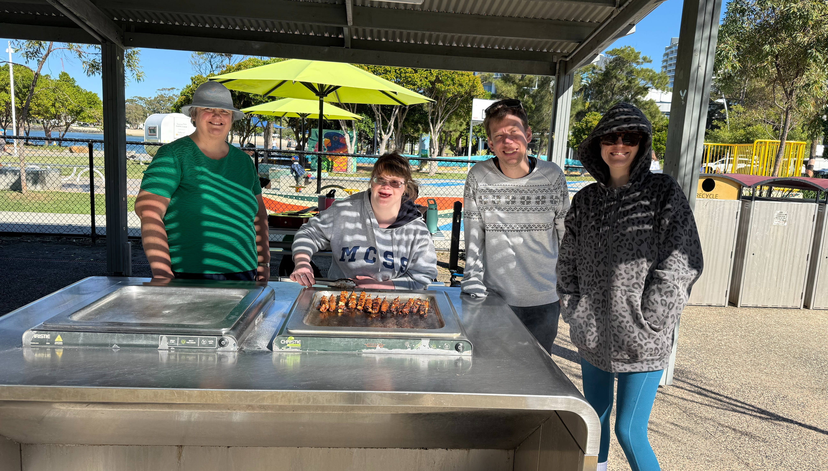
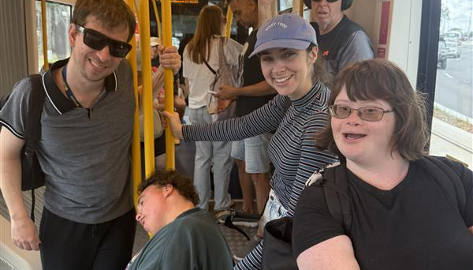
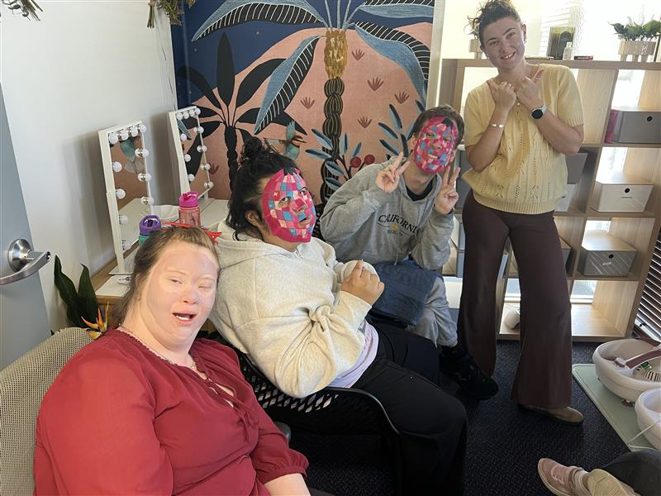



Weekly Program
(6 October 2026 – 11 December 2026)
Tweed Heads
  Group based activities for participants 18+
  Start time 9am Finish time 3pm
Monday
Tuesday
Wednesday
Thursday
Friday
Monday Rock n Slide
Rock and slide Monday
Get ready for an action-packed Monday at Pizzy Park! Rock ‘n’ Slide Monday is about getting outdoors, having fun building confidence and enjoying new experiences together. Participants will have the opportunity to explore the park , take part in the skateboard activities and challenge themselves in the fun supportive environment.
Through out the day the group will be encouraged to develop independence, communication, teamwork and social skills while spending time with friends and participating in the community
    Please bring: Packed morning tea, lunch, water bottle, hat and enclosed shoes
  Activity cost: $0
Discover the World Tuesday
    Pack your imaginary bags because every Tuesday we’re heading off on a new adventure around the world — no passport required! Each week, we’ll discover a different country, learning about its culture, traditions, landmarks, food and fascinating facts. You’ll even get to create your very own travel passport, collecting stamps as you explore! Then put your knowledge to the test with fun quizzes about our country of the week. It’s the perfect way to broaden your horizons, get your globe on, and have a world of fun along the way! 🌍✈️
    Please bring: Packed morning tea, lunch and water bottle.
    Activity cost: $0
Whisk it Wednesday
  Every Wednesday, we’ll be taking our taste buds on a trip around the world one delicious country at a time! Each week, we’ll explore a new cuisine, try out tasty traditional dishes, and cook up a storm together. But there’s a twist… a different Head Chef will be chosen each week to lead the kitchen and take charge of the culinary adventure! Whether you’re a seasoned chef or your cooking skills are still a little half-baked, everyone is welcome. There’ll be plenty of laughs, new flavours and, of course, some serious food for thought. So grab your apron and appetite — Wednesdays are about to be worth the thyme!
  Please bring: Packed morning tea
  Activity cost: $10
Community Connections Thursday
    Get out, get involved and make the most of your Thursday! Community Connections Thursday is about exploring the local area, enjoying different recreational and creative experiences and building confidence while spending time with others. Each week brings something a little different, giving participants the chance to discover new interests and enjoy activity's such as outdoor adventures, photography, music, sport and visit local attractions.
    These days are about much more than the activity itself. Participants are encouraged to build confidence, independence, communication and social skills in a relaxed supportive group environment.
    Please bring: Packed morning tea, lunch, water bottle and enclosed shoes
    Activity cost: $0
Feel Good Friday
Feel-good Friday is the perfect way to wrap up the week on a high note. Fridays are all about relaxing, having fun, and enjoying time together through a mix of games, creative activities, music, cooking, movies, challenges, and chilled out group fun. Whether it’s laughing with friends, trying something new or unwinding after a big week, Feel Good Friday is a safe welcoming space to kick back, connect, and end the week feeling happy relaxed and proud of what you achieved.
    Please bring a packed morning tea and lunch.
    Activity cost: $0
Start the conversation today and contact Ellen Venter
  Tweed Heads Hub 24/28 Corporation Cct, Tweed Heads South NSW 2486
0484058987
Ellen.venter@sunnyfield.org.au
sunnyfield.org.au

